Slide 1
Employee Data Analysis using Excel
STUDENT NAME: LEKHA SRI T
REGISTER NO: 312209096
DEPARTMENT:COMMERCE
COLLEGE: ANNA ADARSH COLLEGE FOR WOMEN

Slide 2
PROJECT TITLE
USING PIVOT TABLE FOR EMPLOYEE TRUNOVER ANALYSIS

Slide 3


AGENDA
Project Overview
End Users
Our Solution and Proposition
Problem Statement
Dataset Description
Modelling Approach
Results and Discussion
Conclusion
3/21/2024 Annual Review

Slide 4

PROBLEM STATEMENT
Employee turnover is a critical issue that affects the overall productivity, morale, and financial health of an organization.
High turnover rates can lead to increased recruitment and training costs, disruptions in operations, and loss of valuable knowledge.
Understanding the factors that contribute to employee turnover is essential for developing effective retention strategies.
The problem is to analyze employee turnover data to identify patterns, trends, and key factors that influence why employees leave the organization.

Slide 5

PROJECT OVERVIEW
This project aims to analyze employee turnover data using pivot tables in Excel. Pivot tables are powerful tools that allow us to summarize, filter, and analyze large datasets with ease.
By utilizing pivot tables, we can explore the data from various angles, identify trends, and gain insights into the reasons behind employee turnover.
The ultimate goal is to help the organization develop data-driven strategies to reduce turnover and improve employee satisfaction.

Slide 6

WHO ARE THE END USERS?
The primary end users of this analysis are:-
HR Managers and Executives: To understand the reasons behind employee turnover and develop strategies to improve retention.-
Department Heads: To identify turnover trends within their departments and address specific issues.-
Senior Leadership: To gain insights into organizational health and make informed decisions regarding workforce management.-
Analysts and Data Scientists: To further explore the data and build predictive models based on the findings from the pivot table analysis.

Slide 7

OUR SOLUTION AND ITS VALUE PROPOSITION
Our solution involves a multifaceted approach to analyzing employee turnover data using Excel's powerful features, including pivot tables, conditional formatting, filtering, and pie charts.
Pivot Tables: We will use pivot tables to summarize and analyze the employee turnover data. Pivot tables allow us to easily slice and dice the data, providing insights into various dimensions.
Conditional Formatting: To highlight critical trends and outliers, we will apply conditional formatting to our pivot tables. For instance, we can use color scales to identify females and persons with salary of more than Rs.50000.
Filtering: Filtering will enable us to drill down into specific subsets of the data.
Pie Charts: Pie charts will be used to visualize the distribution of categorical data.

Slide 8
Dataset Description
This dataset is taken from the website: https://www.kaggl.com
The dataset used for this analysis typically includes the following columns:-
Employee ID: A unique identifier for each employee. Department: The department where the employee worked.(Alphanumeric)
Job Role: The specific role or position held by the employee.(Text)
Gender: The gender of the employee.(Male, Female)
Job type: whether the employee is permanent or temporary.

Slide 9

THE "WOW" IN OUR SOLUTION
What sets our solution apart and adds the "wow" factor is the seamless integration of multiple Excel features—pivot tables, conditional formatting, filtering, and pie charts—into a powerful and intuitive analytical framework. Here’s why our approach stands out:
Holistic Analysis with Depth and Flexibility using Pivot tables.
Immediate Visual Insights using Conditional formatting.
Targeted Exploration using Filtering .
Engaging and Clear Communication using Pie charts.
Actionable Insights at Your Fingertips.
Scalability and Customization.
3/21/2024 Annual Review
9

Slide 10
MODELLING
Step 1: Define the Objectives:- Clearly define what you want to achieve with the analysis, such as understanding turnover patterns, and discovering key factors to engage with HR managers, department heads, and other key stakeholders to understand their specific needs and concerns regarding employee turnover.
Step 2: Collect and Prepare the Data: Collect the employee turnover data from relevant sources, such as HR databases or employee records and remove any duplicates, correct errors, and handle missing values. Make sure all relevant columns are included.
Step 3: Set Up Pivot Tables: Create Pivot Tables: Using Excel, set up pivot tables to summarize the data. Start by dragging and dropping the relevant fields into the Rows, Columns, and Values areas to create meaningful summaries.
Step 4: Apply Conditional Formatting: Highlight Key Trends: Apply conditional formatting to the pivot tables to visually emphasize important trends. For example, use color scales to highlight females , males and salary above certain range.
Set Thresholds: Customize the conditional formatting rules based on specific thresholds or benchmarks relevant to the analysis (e.g., salary above a certain range).
10

Slide 11
Step 5: Use Filtering for Targeted Analysis: Filter Data: Apply filters to focus on specific subsets of the data, such as a particular department, job role, or demographic group. This allows for a more in-depth exploration of turnover within targeted segments of the workforce.
Step 6: Create Visualizations with Pie Charts: Simplify Communication: Use these charts in reports and presentations to clearly communicate the key findings to non-technical stakeholders.
Step 7: Interpret and Present Findings: Analyze Results: Interpret the findings from the pivot tables, conditional formatting, and pie charts to draw meaningful conclusions about the factors driving employee turnover.
Step 8: Develop Recommendations: Strategic Actions: Based on the analysis, develop targeted recommendations for reducing turnover. This might include improving onboarding processes, enhancing employee engagement, or addressing specific issues identified in high-turnover departments.
Step 9: Implement and Follow-Up: Follow-Up Analysis: Conduct follow-up analysis periodically to assess the impact of the implemented strategies and refine them as necessary based on new data.

Slide 12
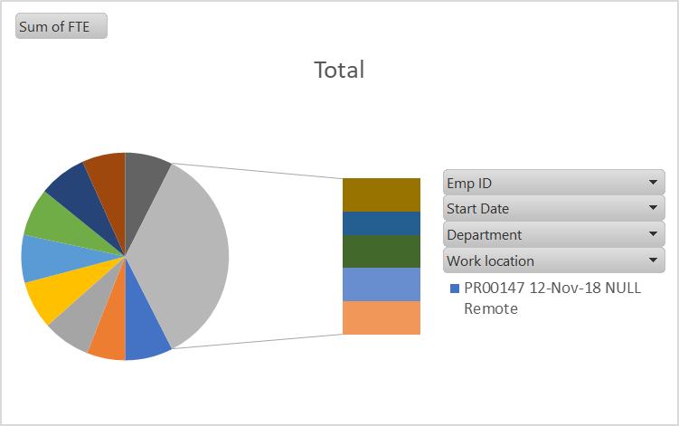
RESULTS
Row Labels | Sum of FTE
PR00147 | 1
12-Nov-18 | 1
NULL | 1
Remote | 1
PR00419 | 0.8
43494 | 0.8
Business Development | 0.8
Remote | 0.8
PR04473 | 1
19-Apr-21 | 1
Business Development | 1
Columbus, USA | 1
PR04601 | 1
44502 | 1
Support | 1
Hyderabad, India | 1
PR04686 | 1
43710 | 1
Business Development | 1
Seattle, USA | 1
SQ00144 | 1
Oct 16, 2020 | 1
Engineering | 1
Wellington, New Zealand | 1
SQ00612 | 1
43466 | 1
Research and Development | 1
Wellington, New Zealand | 1
SQ01854 | 0.9
43643 | 0.9
Marketing | 0.9
Remote | 0.9
SQ04612 | 1
43902 | 1
Services | 1
Remote | 1
TN01281 | 1
27-Jan-20 | 1
Engineering | 1
Wellington, New Zealand | 1
TN02749 | 0.7
2-Apr-18 | 0.7
Training | 0.7
Hyderabad, India | 0.7
VT00578 | 1
Oct 18, 2021 | 1
Services | 1
Remote | 1
VT01803 | 1
Mar 5, 2018 | 1
Training | 1
Seattle, USA | 1
VT02417 | 1
12-Mar-18 | 1
Support | 1
Auckland, New Zealand | 1
Grand Total | 13.4
12

Slide 13
Conclusion
In conclusion, our project on employee turnover analysis using pivot tables, conditional formatting, filtering, and pie charts has successfully demonstrated the power of Excel as a comprehensive tool for HR analytics.
By leveraging these features, we’ve been able to transform raw employee data into meaningful insights that can guide strategic decision-making.
This project not only highlights the versatility of Excel as an analytical tool but also underscores the importance of data-driven decision-making in today’s competitive business environment.
The insights gained from this analysis will serve as a valuable foundation for ongoing efforts to build a more satisfied and stable workforce, driving long-term success for the organization.

